Slide 1
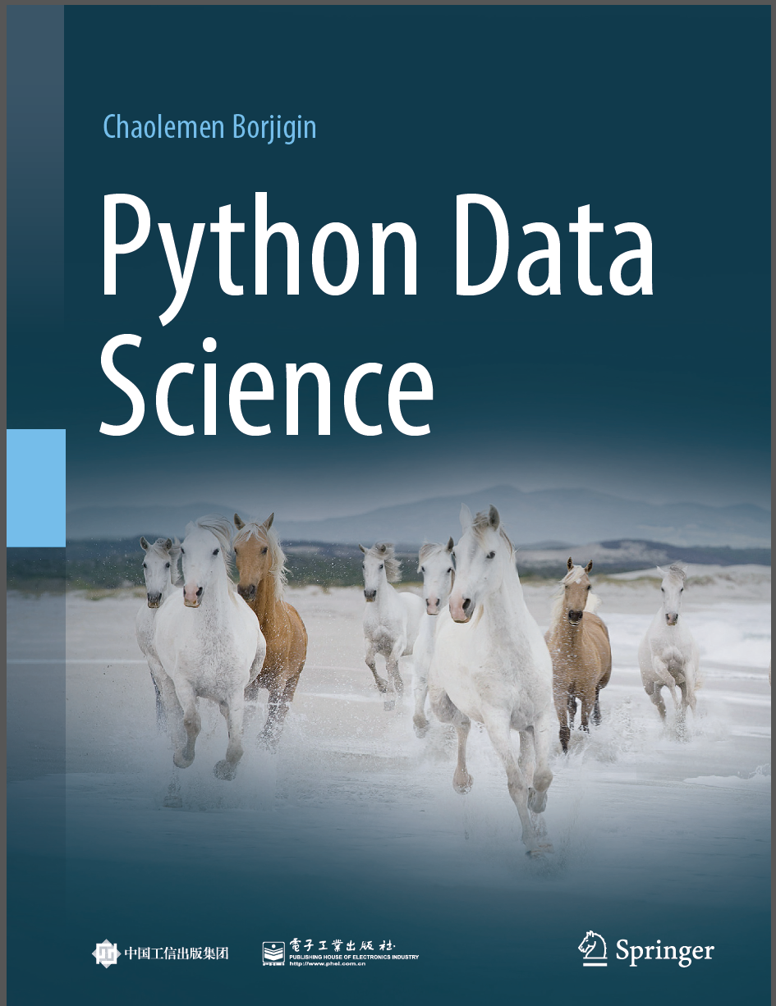
Python Data Science
Chaolemen Borjigin
Renmin University of China
chaolemen@ruc.edu.cn

Slide 2
2.2 Variables
▼ Chapter 2 Basic Python Programming for Data Science
► 2.2 Variables
Chaolemen Borjigin
Renmin University of China
chaolemen@ruc.edu.cn

Slide 3
Summary of this chapter
▼ Chapter 2 Basic Python Programming for Data Science
► 2.2 Variables
2.2.1 Defining variables
2.2.2 Dynamically typed language
2.2.3 Strongly typed language
2.2.4 Variable naming rules
2.2.5 Case-sensitivity

Slide 4
Summary of this chapter
▼ Chapter 2 Basic Python Programming for Data Science
► 2.2 Variables
2.2.6 Variable naming rules
2.2.7 Checking IPython variables
2.2.8 Checking Python keywords
2.2.9 Checking all defined variables
2.2.10 Deleting variables

Slide 5
2.2.1 Defining variables
▼ Chapter 2 Basic Python Programming for Data Science
► 2.2 Variables
In[1]:
testBool=True
testInt=20
testFloat=10.6
testStr="MyStr"
testBool,testInt,testFloat,testStr
Out[1]:
(True, 20, 10.6, 'MyStr')

Slide 6
2.2.2 Dynamically typed language
▼ Chapter 2 Basic Python Programming for Data Science
► 2.2 Variables
In[2]:
x=10
x="testMe"

Slide 7
2.2.3 Strongly typed language
▼ Chapter 2 Basic Python Programming for Data Science
► 2.2 Variables
In[3]:
"3"+2
---------------------------------------------------------------------------
TypeError Traceback (most recent call last)
<ipython-input-3-e8240368dace> in <module>
----> 1 "3"+2
TypeError: can only concatenate str (not "int") to str

Slide 8
2.2.3 Strongly typed language
▼ Chapter 2 Basic Python Programming for Data Science
► 2.2 Variables
In[4]:
3+True
Out[4]:
4
In[5]:
3+3.3
Out[5]:
6.3
In[6]:
3+(1+3j)
Out[6]:
(4+3j)

Slide 9
2.2.4 Variable naming rules
▼ Chapter 2 Basic Python Programming for Data Science
► 2.2 Variables
In[7]:
i=20
i="myStr"
i=30.1
i
Out[7]:
30.1

Slide 10
2.2.5 Case-sensitivity
▼ Chapter 2 Basic Python Programming for Data Science
► 2.2 Variables
In[8]:
i=20
I
---------------------------------------------------------------------------
NameError Traceback (most recent call last)
<ipython-input-8-779b88bd1cc1> in <module>()
1 i=20
----> 2 I
NameError: name 'I' is not defined

Slide 11
2.2.6 Variable naming rules
▼ Chapter 2 Basic Python Programming for Data Science
► 2.2 Variables
In[10]:
myvariable_2=0
In[11]:
2_myvariable=0
File "<ipython-input-11-1eddbc5616ed>", line 1
2_myvariable=0
^
SyntaxError: invalid token

Slide 12
2.2.6 Variable naming rules
▼ Chapter 2 Basic Python Programming for Data Science
► 2.2 Variables
In[12]:
print=0
x=0
print(x)
---------------------------------------------------------------------------
TypeError Traceback (most recent call last)
<ipython-input-12-713cdf74ab27> in <module>()
3 x=0
----> 4 print(x) #报错
TypeError: 'int' object is not callable

Slide 13
2.2.7 Checking IPython variables
▼ Chapter 2 Basic Python Programming for Data Science
► 2.2 Variables
In[13]:
x=12+13
x
Out[13]:
25
In[14]:
In[13])
Out[14]:
'x=12+13\nx'

Slide 14
2.2.7 Checking IPython variables
▼ Chapter 2 Basic Python Programming for Data Science
► 2.2 Variables
In[15]:
Out[13]
Out[15]:
25
In[16]:
_
Out[16]:
25

Slide 15
2.2.8 Checking Python keywords
▼ Chapter 2 Basic Python Programming for Data Science
► 2.2 Variables
In[17]:
import keyword
keyword.kwlist
Out[17]:
['False',
'None',
'True',
'and',
'as',
'assert',
'break',
'class',
'continue',
'def',
'del',
'elif',
'else',
'except',
'finally',
'for',
'from',
'global',
'if',
'import',
'in',
'is',
'lambda',
'nonlocal',
'not',
'or',
'pass',
'raise',
'return',
'try',
'while',
'with',
'yield']

Slide 16
2.2.9 Checking all defined variables
▼ Chapter 2 Basic Python Programming for Data Science
► 2.2 Variables
In[18]:
dir()
Out[18]:
['In',
'Out',
'_',
'_1',
'_13',
'_14',
'_15',
'_16',
'_17',
'_4',
'_5',
'_6',
'_7',
'__',
'___',
'__builtin__',
'__builtins__',
'__doc__',
'__loader__',
'__name__',
'__package__',
'__spec__’,
……
]

Slide 17
2.2.10 Deleting variables
▼ Chapter 2 Basic Python Programming for Data Science
► 2.2 Variables
In[19]:
i=20
print（i)
del i
In[20]:
i
---------------------------------------------------------------------------
NameError Traceback (most recent call last)
<ipython-input-2-397d543883c5> in <module>
----> 1 i
NameError: name 'i' is not defined

Slide 18


